Slide 1
CIOUD COMPUTING
LAIBA MUDASSAR
SP-26BCS-021
ICT

Slide 2
INTRODUCTION :
1.Cloud computing is a technology
2.It provide computer services through the internet
3.User can store data and access online
4.No need for physical storage devices

Slide 3

DEFINITION:
Cloud computing mean delivering computer services
Like software servers over the internet

Slide 4

HISTORY:
1.Concept started in the 1960s
2.became popular in 2000s
3.now use world wide

Slide 5
TYPES OF CLOUD COMPUTING:
Public cloud
Private cloud
Hybrid cloud

Slide 6
Public cloud
Available to every one
Low cost
Private cloud
Used by one organization only
More secure
Hybrid cloud
Combination of public and private cloud
Data can move b/w clouds
Example; google cloud
Used by bank , government offices

Slide 7
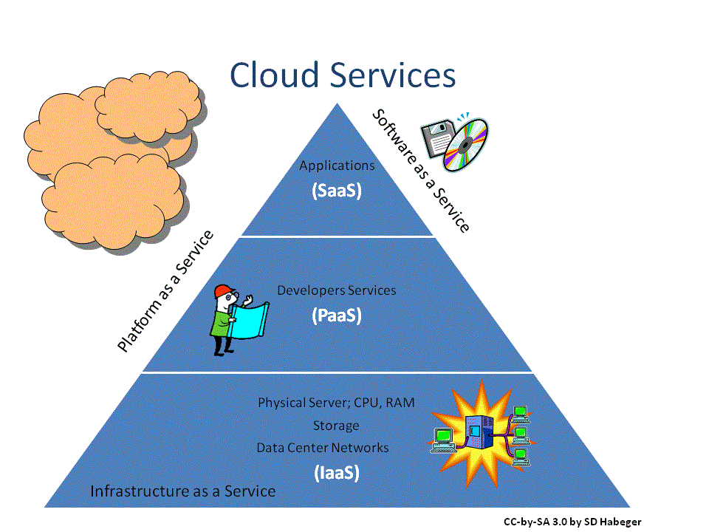
CLOUD SERVICE MODELS :

Slide 8
ADVANTAGES :
1.LOW COST
2. Automatic backup
3.Web hosting
4.High security
5.Data storage

Slide 9
DISADVANTAGES:
1.Data loss
2.Insecure APIS
3.Technology vulnerabilities

Slide 10
CLOUD COMPUTING USAGE GROWTH:

Slide 11
CLOUD PROVIDERS:
COMPANY | SERVICE | FOUNDED
AMAZON | AWS | 2006
MICROSOFT | AZURE | 2010

Slide 12
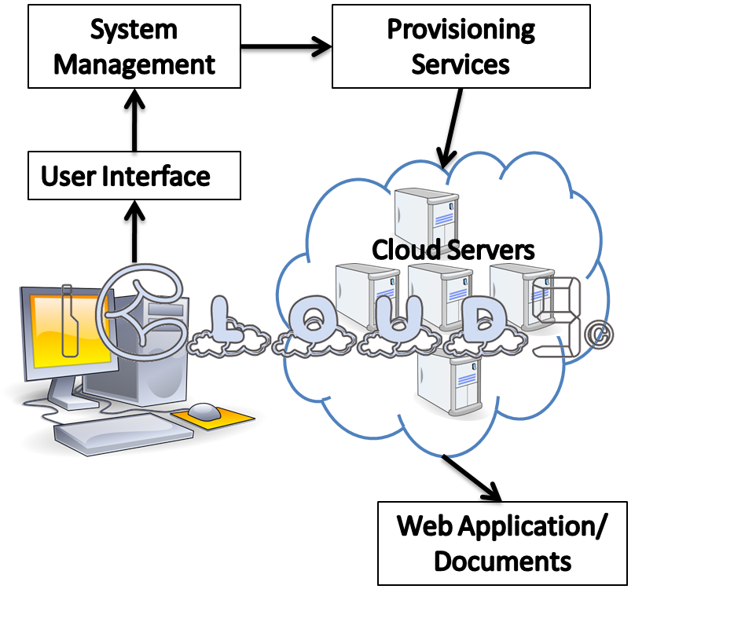
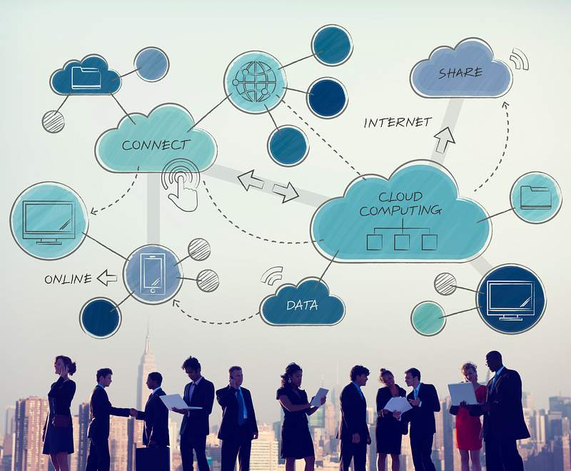
CLOUD COMPUTIMNG:

Slide 13
USES :
1.APP DEVELOPMENT
2.EMAIL SERVICES
3.SREAMING VEDIOS
4.WEBSITE HOSTING
5.ONLINE BACKUP

Slide 14

SCOPE IN COMPUTER SCIENCE:
1.CS student technologies for future jobs
2.Many software run on cloud platforms
3.It supports programming databases and networking

Slide 15
CONCLUSION:
1.It is modern technology
2.Makes data storage easy
3. future of it industry
4.Use in business banking

